Slide 1
ELEC 3300
Project Proposal
Hui Cheuk Hei, Jay (chhuiah)
Chow Hui Yau, Marco (hychowak)
Project: Automatic Page Turner

Slide 2
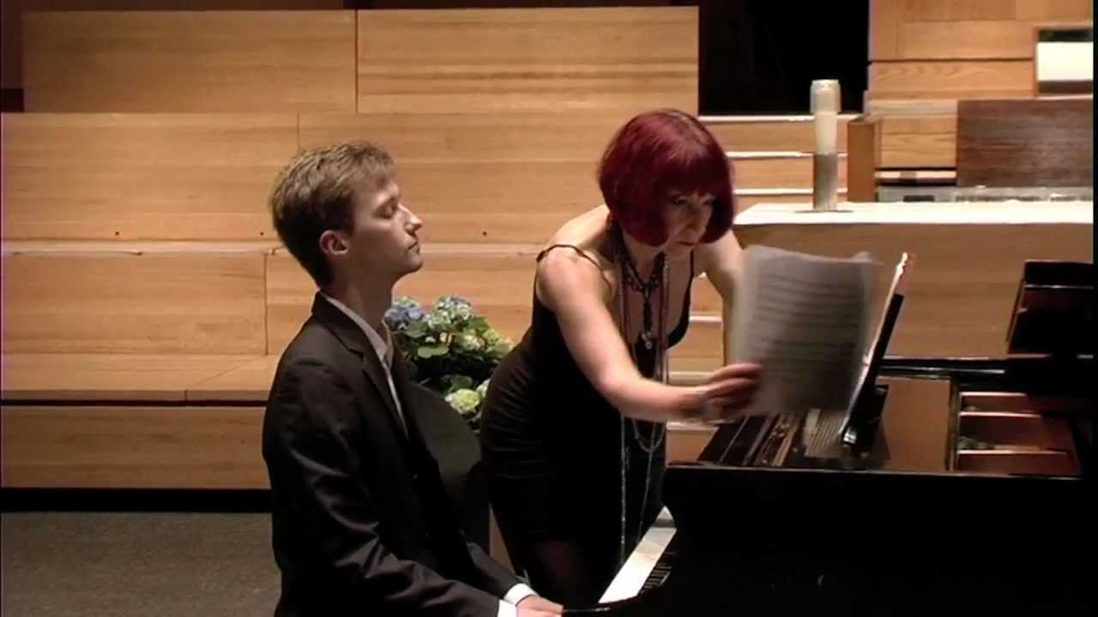

Why this project?
Musicians often require an extra page turner to help turn pages when performing
People with disabilities related to fine motor control (e.g. cerebral palsy) cannot turn pages of a book easily

Slide 3
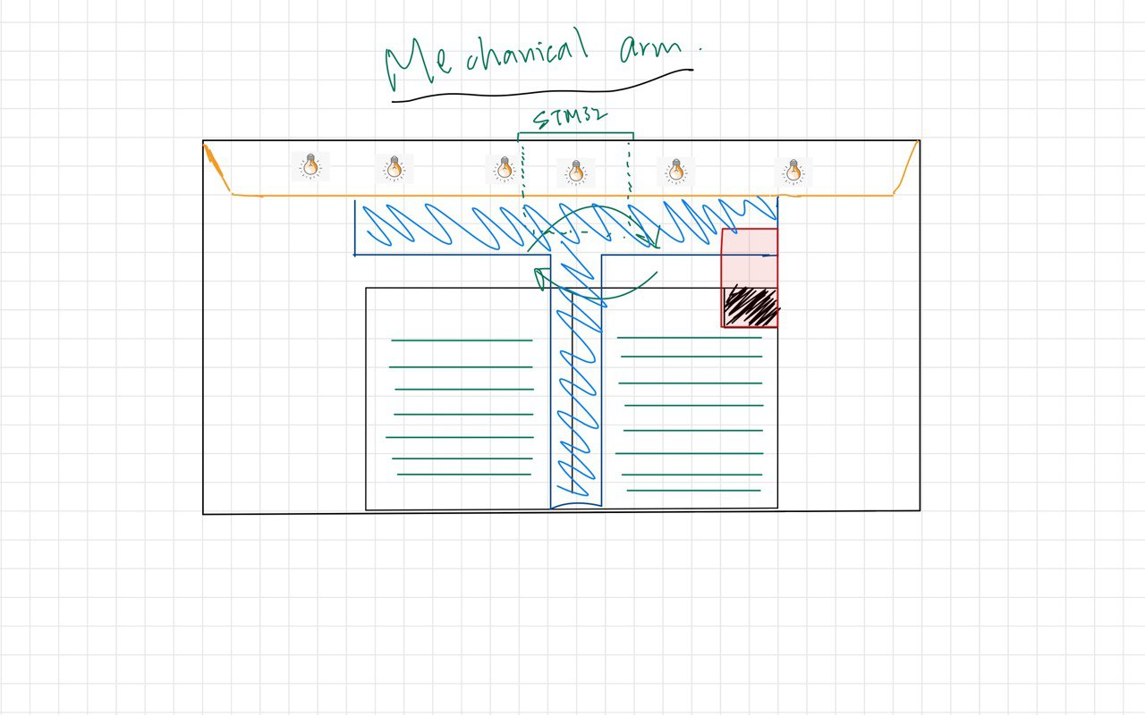
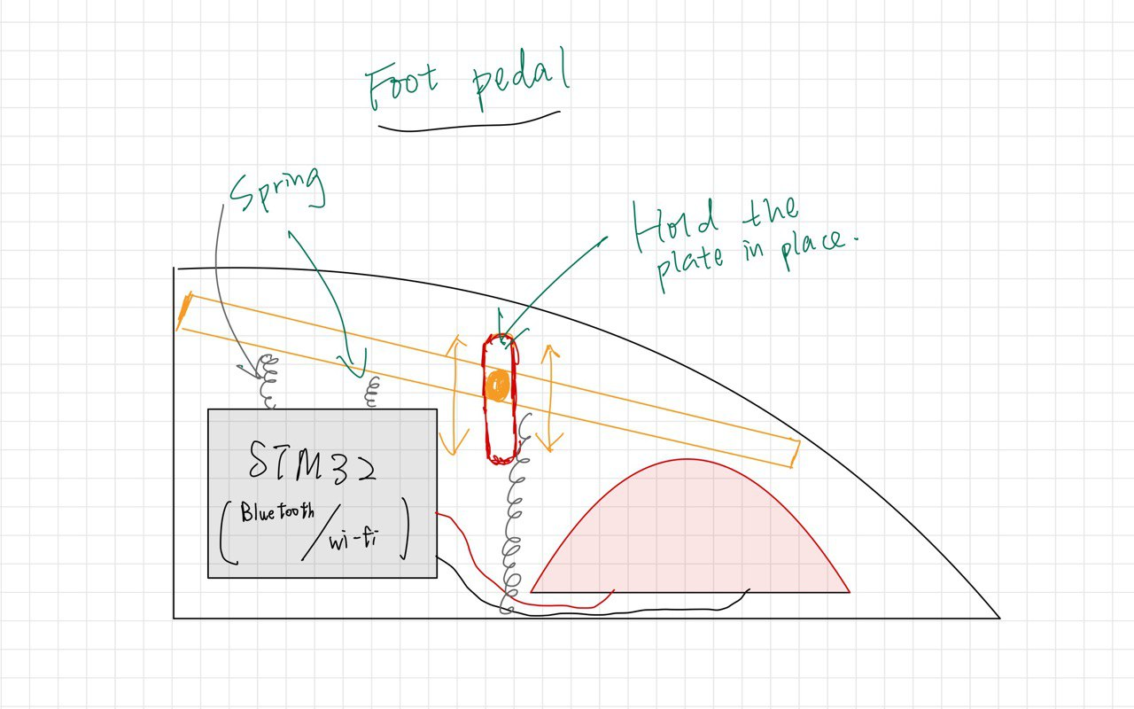
Our page turner
Bluetooth

Slide 4
Our page turner – Foot pedal

Slide 5
Our page turner – Mechanical arm

Slide 6
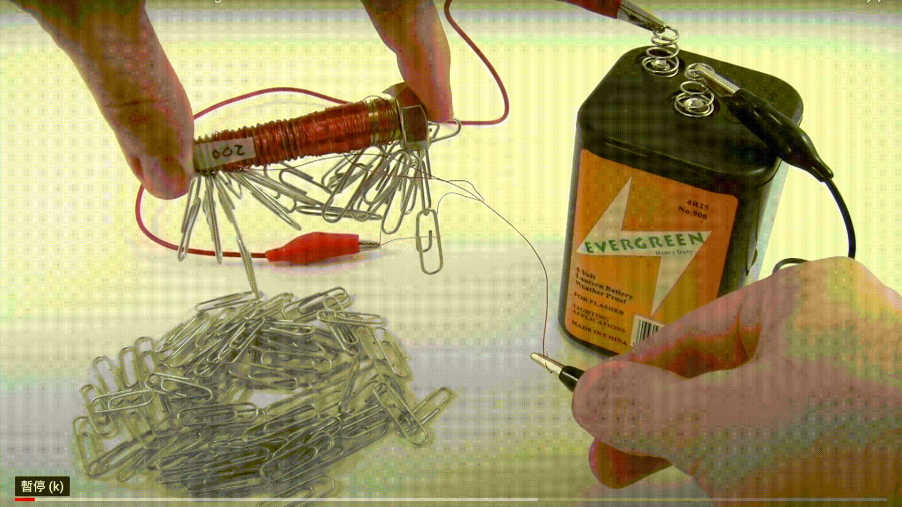
Our page turner – Mechanical arm

